Slide 1
UbiCom Book Slides
Chapter 2
Applications
Name:
Email: Web
Ubiquitous computing: smart devices, environments and interaction

Slide 2
Overview
Early UbiCom Research Projects √
Everyday Applications in the Virtual, Human and Physical World
Some example projects in more detail
Ubiquitous computing: smart devices, environments and interaction

Slide 3
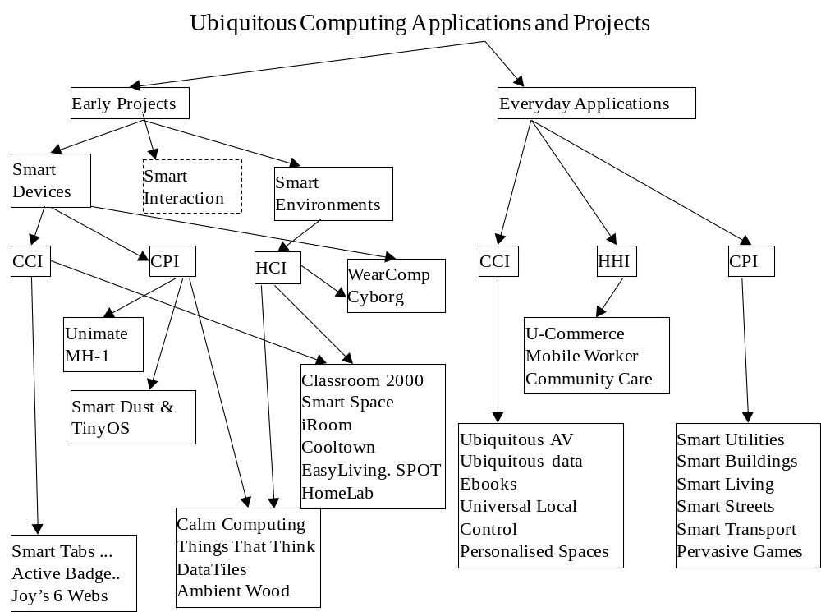
Ubiquitous computing: smart devices, environments and interaction

Slide 4
Early UbiCom Research Projects
Smart Devices: CCI √
  PARC Tab, MPad & LiveBoard; Active Badge, Bat and Floor
Smart Environments: CPI and CCI
  Classroom 2000, Smart Space and Meeting Room, Interactive Workspaces and iRoom, Cooltown, EasyLiving and SPOT, HomeLab and Ambient Intelligence
Smart Devices: CPI
  Unimate and MH-1 Robots, Smart Dust and TinyOS
Smart Devices: iHCI
  Calm Computing, Things That Think and Tangible Bits, DataTiles, WearComp and WearCam, Cyborg
Other UbiCom Projects
Ubiquitous computing: smart devices, environments and interaction

Slide 5
What ICT Environments Were Like
Late 1980s, when much of the early work on UbiComp started
  ???
A distinction has been made in the history between the availability of the first prototypes or ICT product (1) and the first widespread commercial uptake of an ICT product (M).
  Difference between the (1) and (M) phases seems to be averaging about 10 years give or take a few years.
Today, it is hard to imagine such a world, where people were often unreachable if away from a fixed phone point and computing was only available at a desk computer, attached to the wired Internet.
Ubiquitous computing: smart devices, environments and interaction

Slide 6
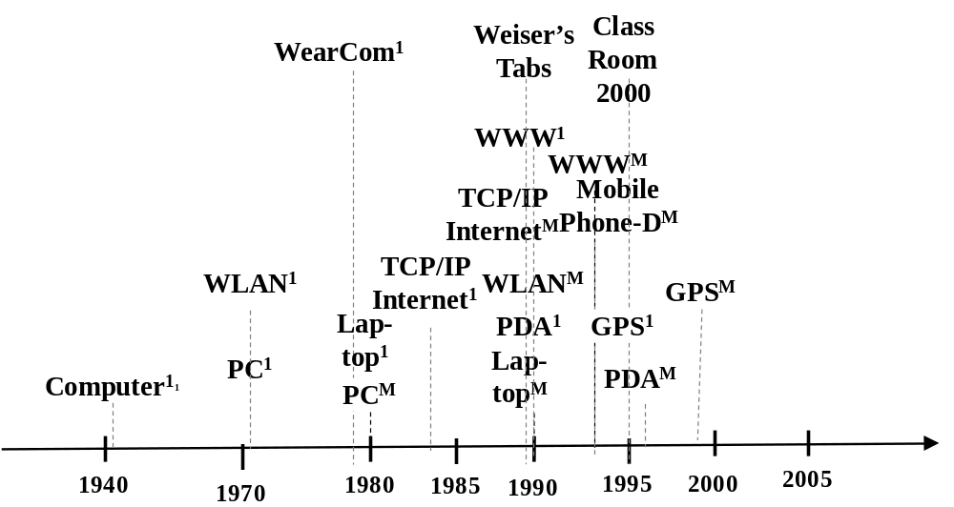
Short History of ICT Technology
Could also note when specific PC technologies arose, e.g., hard-disk, mouse, removal memory cards, etc
Ubiquitous computing: smart devices, environments and interaction

Slide 7
Active Badge, Bat and Floor
Active Badge (forerunner of ParcTab) at Cambridge University / Olivetti
1st context-aware computing application
Designed an aid for a telephone receptionist
Active Badge periodically sends infrared signals to sensors embedded in rooms throughout the building.
Limited Location determination accuracy
See http://www.cl.cam.ac.uk/research/dtg/attarchive/bat/
Ubiquitous computing: smart devices, environments and interaction

Slide 8
Active Badge, Bat and Floor
Active Bat
Uses ultrasound, greater accuracy ~ 3 cm.
Base station used for position determined
Active Floor
Identification by person’s gait,
Pros and Cons
Special Floor design.
Ubiquitous computing: smart devices, environments and interaction

Slide 9
PARC Tab, MPad, LiveBoard
3 main intertwined devices and applications known as known as Boards, Pads and Tabs developed at PARC, Large wall-display program called LiveBoard
Smaller computers Book-sized MPad
Palm-sized ParcTab computer
See http://www.parc.com
Ubiquitous computing: smart devices, environments and interaction

Slide 10
ClassRoom 2000
To capture the live experiences of the occupants and to provide that record to users for later access and review.
1995, Classroom 2000 (led by Abowd, Georgia Institute of Technology)
Most research focussed on development of multimedia-enhanced materials
Classroom 2000 researched content generation by instrumenting a room with the capabilities to automatically record a lecture
See http://www.cc.gatech.edu/fce/eclass/pubs/
Ubiquitous computing: smart devices, environments and interaction

Slide 11
Smart Space and Meeting Room Projects
NIST (1998-2003): use of pervasive devices, sensors & networks for context-aware smart meeting rooms that sense ongoing human activities and respond to them
Meeting Room design.
2 sets of tools were used to manage sensor data.
When people talk, system takes dictation, records a transcript of the meeting, tracks individual speakers, follow what the conversation is about and triggers associated services from the Internet.
Design supports an iHCI model for taking notes and for assisting speakers by intuitively providing further information.
See http://www.nist.gov/smartspace/talksAndPubs.html
Ubiquitous computing: smart devices, environments and interaction

Slide 12
Interactive Workspaces Project
Interactive Workspaces project (Stanford University, 1999 ) investigated design and of rooms (iRooms) to create applications integrating the use of multiple types of devices of varying form factors
Also developed several interaction patterns for interacting with large high resolution displays
FlowMenu
ZoomScape
Typed drag and drop support:
See http://graphics.stanford.edu/papers/iwork-overview/
Ubiquitous computing: smart devices, environments and interaction

Slide 13
Cooltown
HP Project , 2000-2003, to develop a vision of UbiCom to support:
  Key feature of Cooltown is that each physical and virtual world resource has a Web presence (URL)
3 important benefits of using the Web for Mobile users situated in the physical world:
  Ubiquitous access
  Just Enough Middleware
  Local means local:
Ubiquitous computing: smart devices, environments and interaction

Slide 14
EasyLiving & SPOT
EasyLiving project (Microsoft, 1997-2003) developed intelligent environments to support dynamic aggregation of diverse I/O devices into a single coherent user experience.
SPOT devices (Microsoft, 2003) designed to listen for digitally encoded data such as news stories, weather forecasts, personal messages, traffic updates, and retail directories transmitted on frequency sidebands leased from commercial FM radio stations
Ubiquitous computing: smart devices, environments and interaction

Slide 15
Ambient Intelligence (AmI)
Proposed by Philips in late 1990s as a novel paradigm for consumer electronics that is sensitive responsive to the presence of people
& became part of a EU Research Framework (FP6 IST)
Key properties of AmI systems are:
  User-aware / iHCI:
  Intelligence?:
  Embedded:
Ubiquitous computing: smart devices, environments and interaction

Slide 16
Unimate and MH-1 Robots
Machines are used to perform physical tasks that are very labour intensive and repetitive or are too dangerous or difficult for humans to implement directly.
Automated machines that just do one thing are not robots.
Robots have the capability of handling a range of programmable jobs.
1961, Ernst developed the MH-1
1st first industrial computer controlled robot, the Unimate designed by Engelberger
Ubiquitous computing: smart devices, environments and interaction

Slide 17
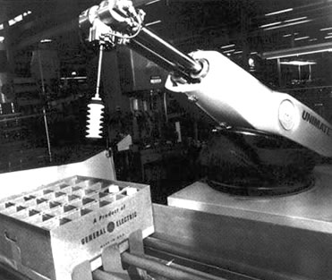
Unimate Robot
See http://www.thocp.net/reference/robotics/robotics2.htm
Ubiquitous computing: smart devices, environments and interaction

Slide 18
Smart Dust
Micro fabrication and integration of low-cost sensors, actuators and computer controllers, MEMS (Micro Electro-Mechanical Systems)
Can be sprayed & embedded throughout the digital environment
Creating a digital skin that senses physical & chemical phenomena
See Smart Dust project (Pister, UCB)
Ubiquitous computing: smart devices, environments and interaction

Slide 19
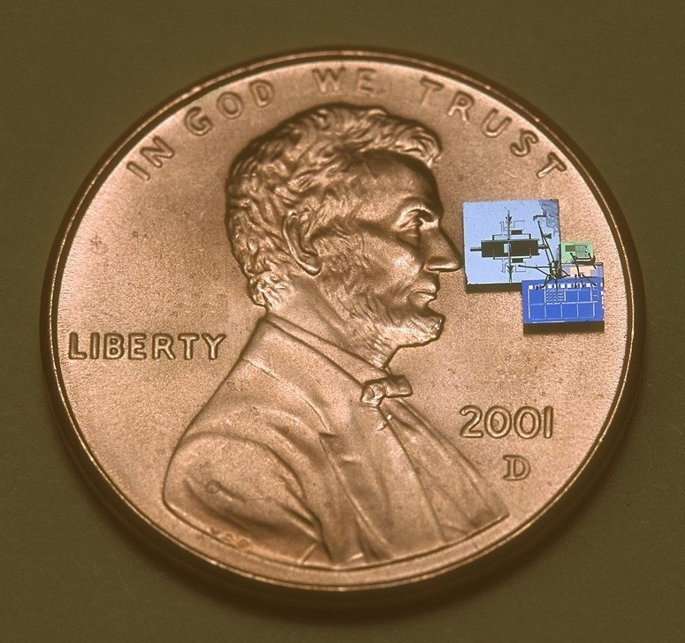
Smart Dust
Photo: courtesy of Brett Warneke
Ubiquitous computing: smart devices, environments and interaction

Slide 20
iHCI: Calm Computing
Weiser noted whereas computers and games for personal use have focused on the excitement of interaction, when computers are all around we will interact with them differently. We often want to compute while doing something else.
Calm technologies are said to encalm us as they can empower our periphery in three ways:
Ubiquitous computing: smart devices, environments and interaction

Slide 21
iHCI: Calm Computing
Example of calm technology was the “Dangling String” created by artist Natalie Jeremijenko, situated at PARC
String jiggled in proportion to the degree of subnet activity
Ubiquitous computing: smart devices, environments and interaction

Slide 22
iHCI: Tangible Bits & Things That Think (TTT)
In 1997, and still to a large extent10 years later, GUI-based HCI displayed its information as "painted bits" on rectangular screens in the foreground
In contrast, Tangible Bits project (led by Ishii, MIT, 1997) aimed to change "painted bits", into "tangible bits" by leveraging multiple senses & multimodal human interactions within the physical world
"Tangible User Interfaces" emphasize both visually intensive, hands-on foreground interactions, and background perception of ambient light, sound, airflow, and water flow at the periphery of our senses.
See http://ttt.media.mit.edu/, http://tangible.media.mit.edu/,
Ubiquitous computing: smart devices, environments and interaction

Slide 23
DataTiles
DataTiles project (Sony, 2001, led by Rekimoto) focussed on interactive user interfaces that use task specific physical objects as alternatives to conventional HCI.
System consists of acrylic transparent tiles with embedded RFID tags
Advantages ?
Three key types of interaction were embodied by the system.
Ubiquitous computing: smart devices, environments and interaction

Slide 24
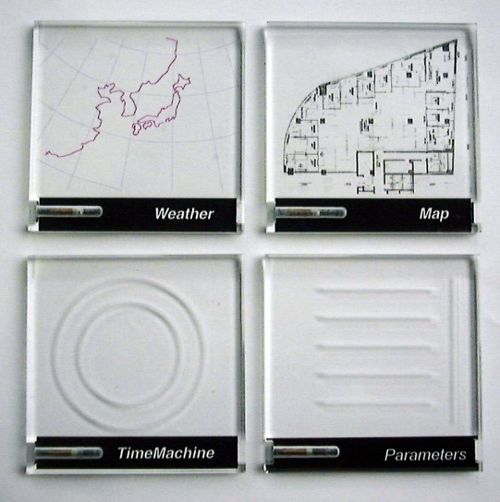
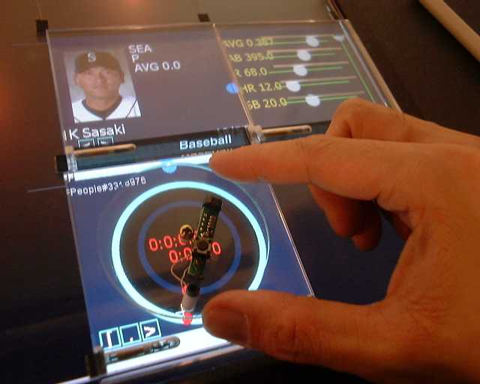
DataTiles
Photo courtesy of Sony Computer Science Laboratories, Inc.
Allows users to manipulate data in form of tangible “tiles”
Combinations of data streams and functions make it possible to create new applications
Ubiquitous computing: smart devices, environments and interaction

Slide 25
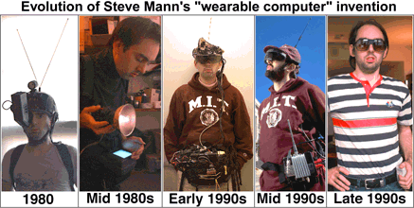
WearComp and WearCam
Mann’s experiments with wearable computers started in late 1970s.
Main application was recording personal visual memories that could be shared with other via the Internet.
Photo courtesy of http://en.wikipedia.org/wiki/Wearable_computing
Ubiquitous computing: smart devices, environments and interaction

Slide 26
WearComp and WearCam
Later generations of WearComp supported three key features.
Wearable computer was hidden. Customised glasses used as HUD, conductive fabric used as BAN.
Mediated reality was supported, reality may be diminished or otherwise altered as desired, not just augmentered.
Thirdly, Homographic Modelling was supported in the display.
See http://www.eecg.toronto.edu/~mann/
Ubiquitous computing: smart devices, environments and interaction

Slide 27
Cyborg 1.0 and 2.0
Implanted into human mobile hosts are a form of embedded device.
Cyborg 1.0, a silicon chip transponder implanted in a forearm which remained in place for 9 days (1998, Warwick)
Cyborg 2.0 (2002, Warwick) new implant in his lower arm could send signals back and forth between the nervous system and a computer
See http://www.kevinwarwick.com/
Ubiquitous computing: smart devices, environments and interaction

Slide 28
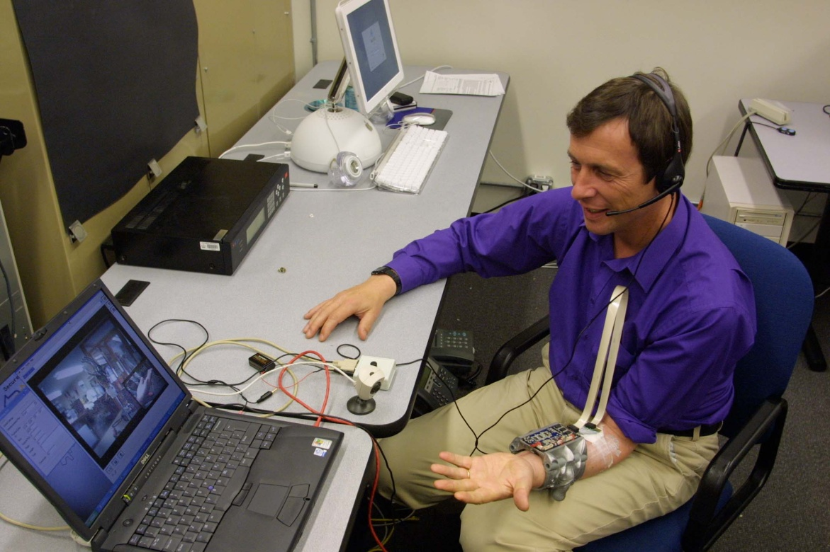
Cyborg 2.0
Electrode array surgically implanted into Warwick’s left arm and interlinked into median nerve fibres is being monitored.
Photo Courtesy of University of Reading
Ubiquitous computing: smart devices, environments and interaction

Slide 29
R&D UbiCom Applications
There are many other innovative UbiCom projects, only a selection of these is given here.
Two of the main conferences that cover a greater range of UbiCom projects are:
  IEEE http://www.UbiCom.org
  ACM http:// www.percom.org
Research here (add-link) for what your institute is doing in this area
Ubiquitous computing: smart devices, environments and interaction

Slide 30
Analysis of Early Projects Achievements and Legacy
Focus on 3 basic UbiComp properties: iHCI, context awareness and distributed access
Many innovative iHCI projects
.
Ubiquitous computing: smart devices, environments and interaction

Slide 31
Analysis of Early Projects: Distributed Access Support
Early work at PARC and by Olivetti, late 1980s was focussed on basic smart mobile device model design for Tabs and Pads.
Proprietary communication & location-awareness for mobile users : no commercial mobile ICT devices, widely available wireless networks.
Late 2000s, mobile devices and wireless networks are widely available
Service discovery of local network resources was weak and the discovery of other local environment resources is still virtually non-existent
-> Much of the vision of Cooltown is not routinely available.
  Reasons for this?
Ubiquitous computing: smart devices, environments and interaction

Slide 32
Analysis of Early Projects: context-awareness
Context-awareness: mainly location awareness
Early achievements based upon (local not global) location awareness indoors with heavily instrumented environment.
Location-determinism today tends to be supported mainly as stand-alone devices and services that are not readily interoperable.
GPS for outdoor use.
Systems for indoor use are available today based, e.g., based upon trilateration using WLAN but not ubiquitous (See Chapter 8)
Ubiquitous computing: smart devices, environments and interaction

Slide 33
Analysis of Early Projects: iHCI
Electronic boards
  Allow users to collaboratively edit text and graphics were prototyped at PARC in the early 1990s -> later became commercial products.
  Used in Classroom 2000 in 1995-1998 by Abowd et al. -> now routinely used in many educational establishments that support distance learning.
Wearable smart devices
  still in infancy, several products are available but they are not yet in pervasive use.
iHCI
  is a continuing research initiative.
  Very many variations – not clear which will catch on, if there is a mass market for each of these.
Ubiquitous computing: smart devices, environments and interaction

Slide 34
Student Project Ideas
???
Ubiquitous computing: smart devices, environments and interaction

Slide 35
Overview
Example Early UbiCom Research Projects
Everyday Applications in the Virtual, Human and Physical World √
Some Example Projects in More Detail
Ubiquitous computing: smart devices, environments and interaction

Slide 36
Everyware UbiCom Applications
Vision: ubiquitous computer systems to support people in their daily activities in the physical world tasks to simplify these and to make these less obtrusive.
People will live, work, and play in a seamless computer enabled environment that is interleaved into the world.
Bushnell (1996) coined variations of term ware such as deskware, couchware, kitchenware, autoware, bedroomware and bathware to reflect the use of ubiquitous computing for routine tasks.
Greenfeld (2006) used the term everyware to encompass the many different types of ware
Ubiquitous computing: smart devices, environments and interaction

Slide 37
Everyware UbiCom Applications
Many ways to categorise UbiCom applications from an end-user perspective:
Here we categorise applications with respect to:
  smart mobile device versus smart environment
  by type of environment interaction such as CCI, HCI and CPI.
Ubiquitous computing: smart devices, environments and interaction

Slide 38
Everyware UbiCom Applications: CCI
Ubiquitous Networks of Devices: CCI
  Human Computer Interaction
  Ubiquitous Audio-Video Content Access
  Ubiquitous Information Access and Ebooks
  Universal Local Control of ICT Systems
  User-awareness and Personal Spaces
Ubiquitous computing: smart devices, environments and interaction

Slide 39
Ubiquitous MM Content Access
Multi-media (MM) content via any network & access device
Broadcast MM content, professionally, created by third-parties, copyright, non-interactive, downloaded, read-only content, stored & manipulated in access device.
User generated, locally created content that is modifiable
From 1 to many content services per network
Ubiquitous computing: smart devices, environments and interaction

Slide 40
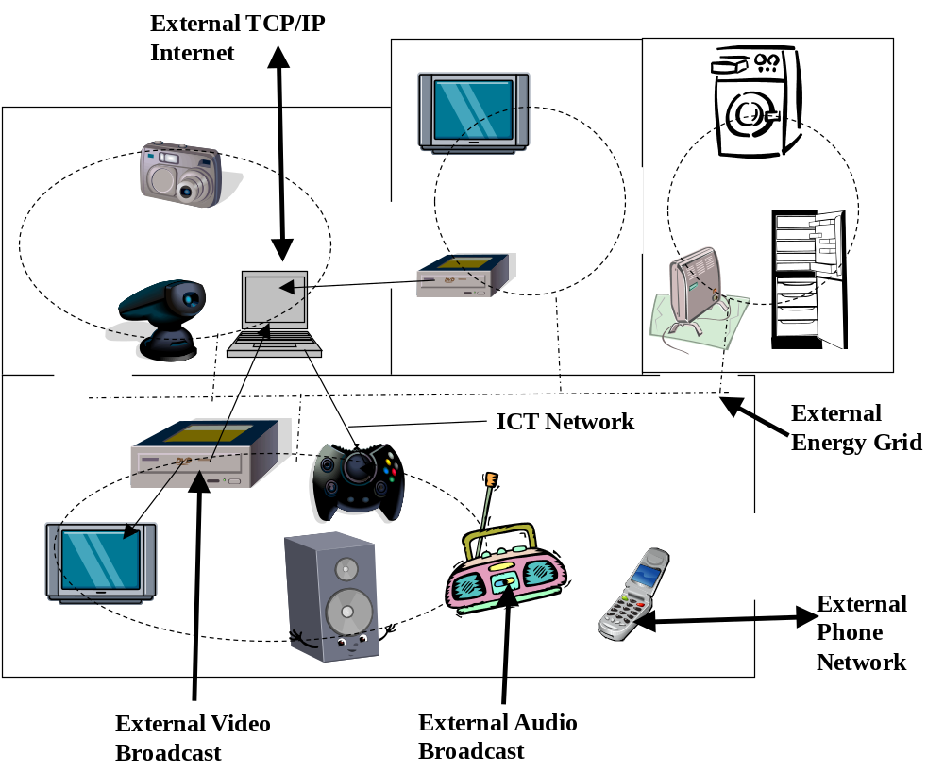
Ubiquitous computing: smart devices, environments and interaction

Slide 41
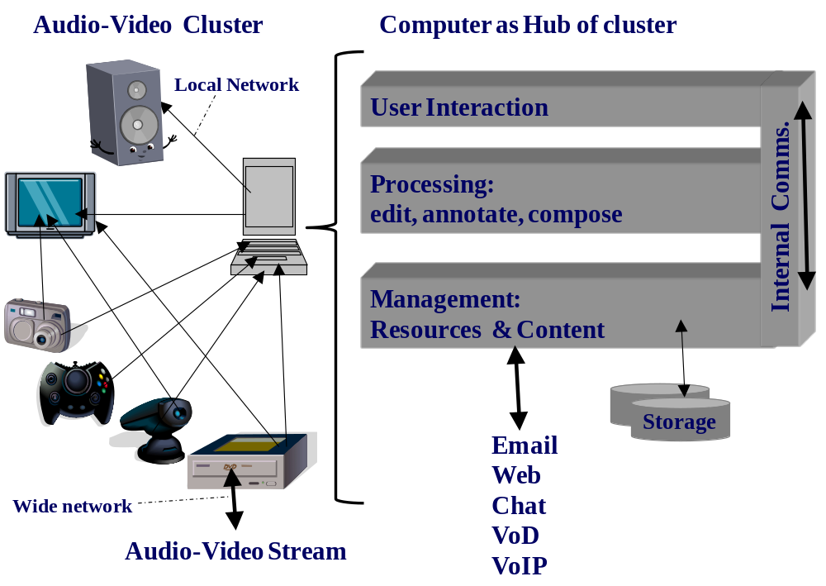
Ubiquitous computing: smart devices, environments and interaction

Slide 42
Universal Information Access
PC still the dominant information access device
PC suffers from a number of limitations compared to its paper counterpart. What?
Specialised reading devices: ebooks, epaper
  E.g. www.sonystyle.com, www.amazon.com (kindle, USA only when 1st released)
Good Content adaptation & layout critical
  Microsoft Word, Adobe Acrobat, Web browsers have many limitations
Ubiquitous computing: smart devices, environments and interaction

Slide 43
Universal Control of Local Devices
Appliances controlled using Infrared, short-range controller
Some well known conventions are used to label common function buttons
No convention for less common functions –> read the manual.
1 controller per appliance -> many controllers, discarded each time, appliance is upgraded
Two types of hand-held universal local control device have been proposed that can be configured for multiple local devices:
Use of mobile phones and PDAs as universal local controllers?
Focus on control of virtual rather than physical services
Ubiquitous computing: smart devices, environments and interaction

Slide 44
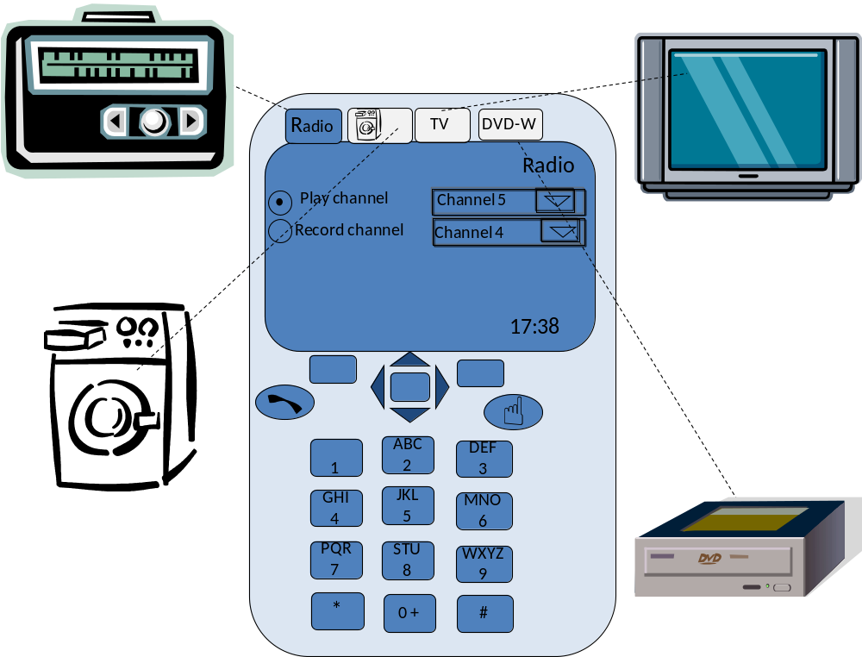
Ubiquitous computing: smart devices, environments and interaction

Slide 45
User Awareness & Personalisation
Personalisation: content and services tailored to individuals based upon on knowledge about their preferences and behaviour. Benefits
Greater convenience, more relevant filtered information
but trade off against a loss in privacy.
Users can personalise configuration of services, annotation of content
Personal preferences could follow a user around
Mobile devices provide an obvious means for users to personalise their environment
Ubiquitous computing: smart devices, environments and interaction

Slide 46
Student Project Ideas
???
Ubiquitous computing: smart devices, environments and interaction

Slide 47
Everyware UbiCom Applications: HHI
Human to Human Interaction (HHI)
  Transaction-based M-Commerce & U-Commerce services
  Enhancing the Productivity of Mobile Humans
  Care in the Community
Ubiquitous computing: smart devices, environments and interaction

Slide 48
M-commerce and U-Commerce
M-Commerce: variant of E-Commerce with services over mobile-wireless infrastructure
U-Commerce Sub-type of eCommerce / mCommerce
  (Watson et al. 2002)
Characterised by:
  Universality:
  Uniqueness:
  Unison:
  Ubiquity:
Ubiquitous computing: smart devices, environments and interaction

Slide 49
Enhancing Productivity of Mobile Humans
Productivity can suffer from a bottleneck when people don't have the right information where & when they need it
  E.g.,
Mobile users can access calls, email, diary, calendar and notepads
  Does greater mobile service access empower or enslave us?
Two-way interaction versus unilateral workflow across time & space
  e.g.,,.
Communities of practice
Challenges?
Ubiquitous computing: smart devices, environments and interaction

Slide 50
Care in the Community
‘Vulnerable’ individuals at home monitored by friends, family and health professionals situated elsewhere.
There are two basic kinds of approaches in terms of:
  whether the subject explicitly asks for help from others or
  Whether others can anticipate when the subject requires help.
Ubiquitous computing: smart devices, environments and interaction

Slide 51
Project Ideas
Mobile services: various
Combined Indoor and outdoor spatial information system
Care in the Community: sensing activity
Etc.
Ubiquitous computing: smart devices, environments and interaction

Slide 52
Everyware UbiCom Applications: (HPI, CPI)
Physical Environment Awareness
(Physical) Environment Control
Smart Utilities (See Chapter 1)
Smart Buildings and Home Automation
Smart Living Environments and Smart Furniture
Smart Street furniture
Smart Vehicles, Transport and Travel
Pervasive Games and Social Physical Spaces
Ubiquitous computing: smart devices, environments and interaction

Slide 53
Physical Environment Awareness
Services slanted towards specific physical environment contexts, e.g.,
Short-range (point-based, static) context determination
Longer range(regional, roaming) context access
Sensors for specific physical world phenomena are statically embedded into specific devices and services, e.g.,
Ubiquitous computing: smart devices, environments and interaction

Slide 54
(Physical) Environment Control
Mobile phone or other hand held device can use a wireless link to issue simple control instructions
  E.g.,
Resources may be public, private, commercial
privately owned, e.g., garage door or car door
  .
provided as pay per use services, e.g. drinks dispenser
N.B. control and reconfiguration of many devices is manual
Ubiquitous computing: smart devices, environments and interaction

Slide 55
Smart Buildings and Home Automation
Sensors & automation is increasing used in buildings to automate control of light, climate, doors, windows, security, ↑ energy efficiency.
Sensors & control devices can be put in physical environment in a variety of ways
Home automation, e.g., X10, seems more common in U.S. vs Europe
Building today not well suited to keep pace with rapid technological changes and with recent sustainability concerns.
Ubiquitous computing: smart devices, environments and interaction

Slide 56
Smart Living Environments and Smart Furniture
Several smart environment devices can adapt to human activities.
Doors, lighting, taps and air ventilation can be designed to detect the presence of humans, to be activated by them and to adapt to them.
Smart fridge behaves as a stock-control system
MediaCup (Beigl et al., 2001)
Smart chairs such as SenseChair (Forlizzzi et al., 2005)
Smart clocks e.g., Microsoft wherabouts clock.
Smart mirrors: can move to adapt view, e.g., as car moves, can overlay other information, can link to cameras.
Smart wardrobe , smart bed, smart pillow Smart Mat, smart sofa (Park et al. 2003).
Ubiquitous computing: smart devices, environments and interaction

Slide 57
Smart Vehicles, Transport and Travel
Embedded computer systems increasingly being used within vehicles.
Improves operation such as automatically controlling or providing assisted control.
Automatically guided vehicles along track
Inform waiting passengers of the status of arriving & departing vehicles.
Location determination for remote tracking of vehicles
Access travel info. much more conveniently
Travel Tickets are also smarter – see smart cards (Chapter 4)
Access to Internet in moving smart vehicles
Ubiquitous computing: smart devices, environments and interaction

Slide 58
Social Physical Spaces & Pervasive Games
On detecting friends within a local vicinity, suggest meeting point, e.g., ImaHima
Local traders electronic offers.
Many social and economic issues ,
Games: a core type of entertainment, social, interactive, application.
Traditional or pre-electronic games: 2 types of interaction, HPI and HHI, uses game control interface (d-pad interface)
In pervasive gaming, social activities and games exploit the potential of combining the physical space
Electronic game types: mobile games, location-based games, Augmented reality games, Adaptronic games, Pervasive games..
Ubiquitous computing: smart devices, environments and interaction

Slide 59
Project Ideas
???
Ubiquitous computing: smart devices, environments and interaction

Slide 60
Overview
Example Early UbiCom Research Projects
Everyday Applications in the Virtual, Human and Physical World
Some Example Projects in More Detail √
Ubiquitous computing: smart devices, environments and interaction

Slide 61
Example 1:
Instructors to add examples here
Ubiquitous computing: smart devices, environments and interaction

Slide 62
Summary & Revision
For each chapter
See book web-site for chapter summaries, references, resources etc.
Identify new terms & concepts
Apply new terms and concepts to old and new situations & problems
Debate problems, challenges and solutions
See Chapter exercises on web-site
Ubiquitous computing: smart devices, environments and interaction

Slide 63
Exercises: Define New Concepts
Cooltown etc
Ubiquitous computing: smart devices, environments and interaction

Slide 64
Exercise: Applying New Concepts
(See Web-site: http://www.elec.qmul.ac.uk/people/stefan/ubicom)
Ubiquitous computing: smart devices, environments and interaction

